Slide 1




CHANGING THE GAME IN
ADOLESCENT-CENTERED DESIGN:
ASSETS, ACCESS, ADHERENCE
#changingthegame #AIDS2108
Please tag @grassrootsoccer

Slide 2
Putting youth at the centre for successful demand creation
HIV Self-Testing HCD Challenge Fund and Adolescents 360

Slide 3
Contents
CIFF Adolescence Strategy
Adolescents 360
HIV Self-Testing HCD Challenge Fund

Slide 4
CIFF’s Adolescence Strategy
… Tied to a resilient, tailored, country-led response
And change the future
A world where every adolescent can exercise their sexual and reproductive health rights with access to the services they want.
Confront discrimination related to adolescent sexual and reproductive health
Prevent unplanned teenage pregnancy and new HIV infections today…
Get informed adolescents at the centre of the debate
Get the right tools, products, and methods in the hand of users
We are bringing ground breaking products to market, making them more affordable and accessible for girls
We are changing the way sexual health information and services are delivered

Slide 5
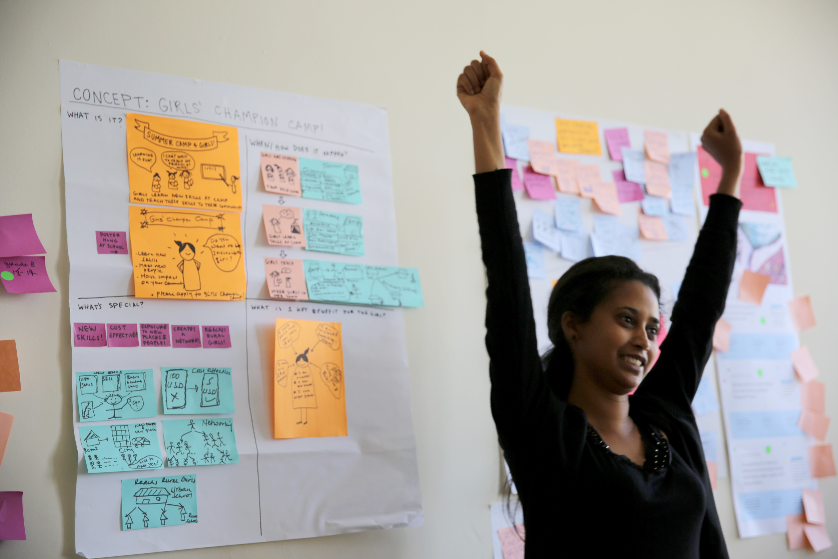


Sparking a
Human-Centered
Revolution
Reimagining contraceptive services
with girls, for girls to unlock hope
& rapid contraceptive uptake.

Slide 6






Adolescents 360: A Blueprint for Rapid Change
Through HCD, A360 is reimagining how adolescents access contraception—with her, for her
260+ young people are at the center of A360
A360 supports a girl’s emotional decision to use contraceptives as a first step to achieving her life goals
A360’s blueprint is voluntary adoption of a contraceptive method through a single, brief contact

Slide 7
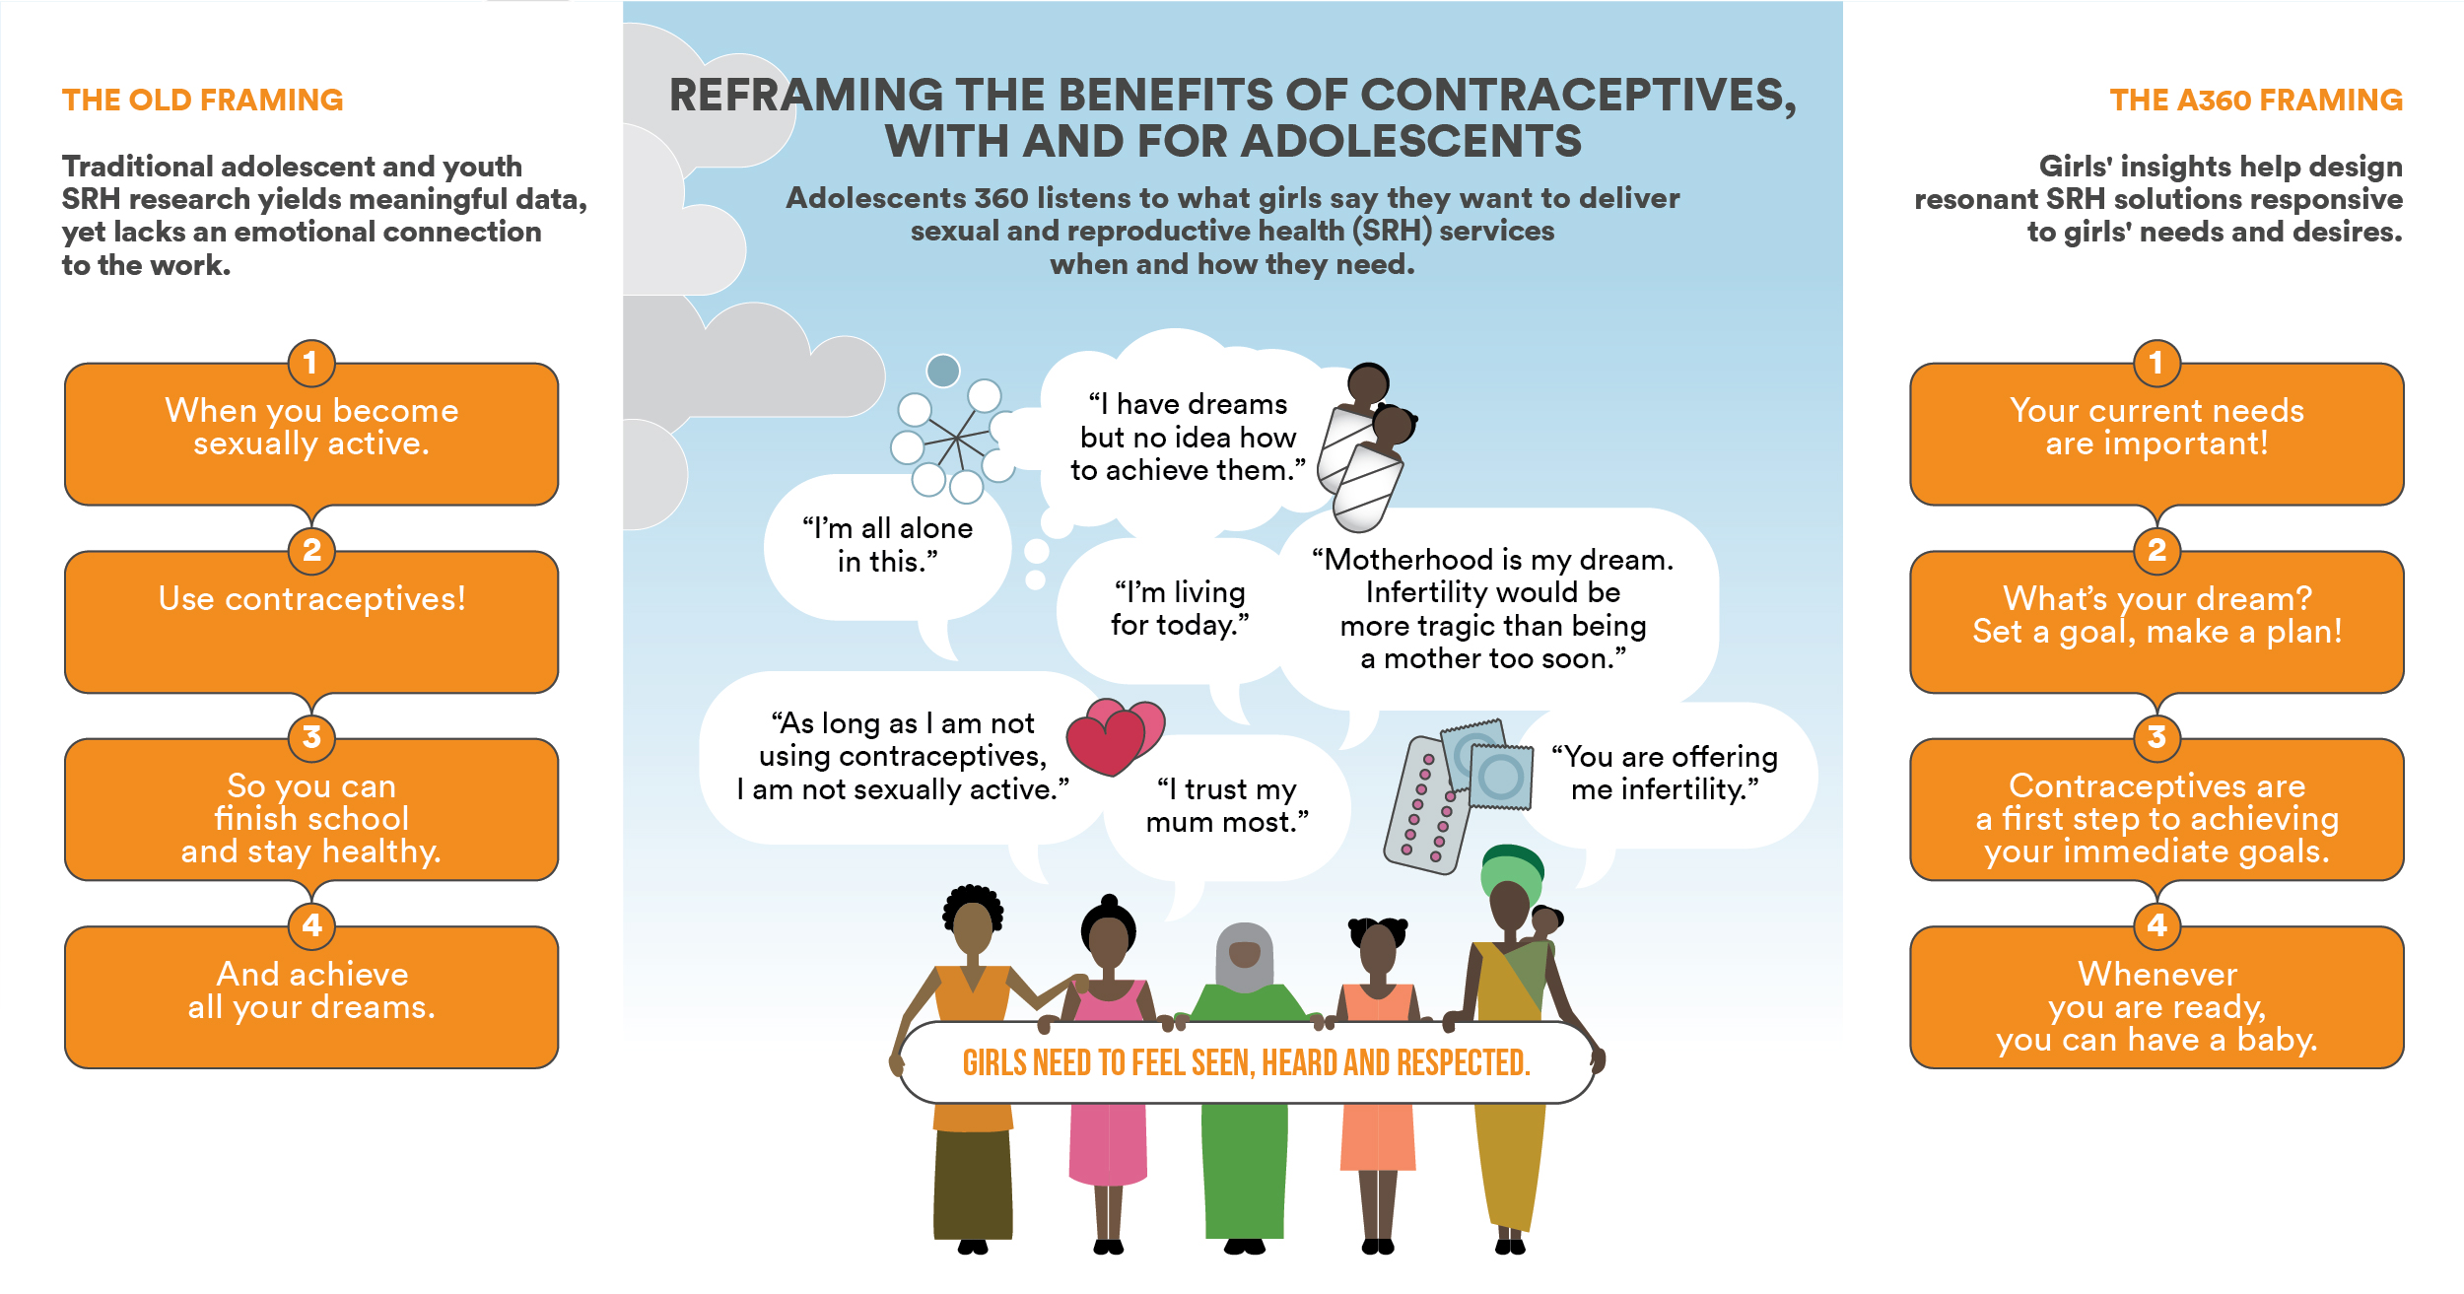

Slide 8




Girls’ insights drive A360’s solutions
Ethiopia: financial planning to initiate contraceptive counseling with rural, married girls.
Method Mix: 22% LARCs*
Tanzania: a mini-life coaching interaction that leads to opt-out private sessions with providers.
Method Mix: 71% LARCs*
Nigeria: vocational training that feeds into contraceptive counseling.
Method Mix: 16% LARCs*
LARCs= Long Acting Reversible Contraceptives

Slide 9
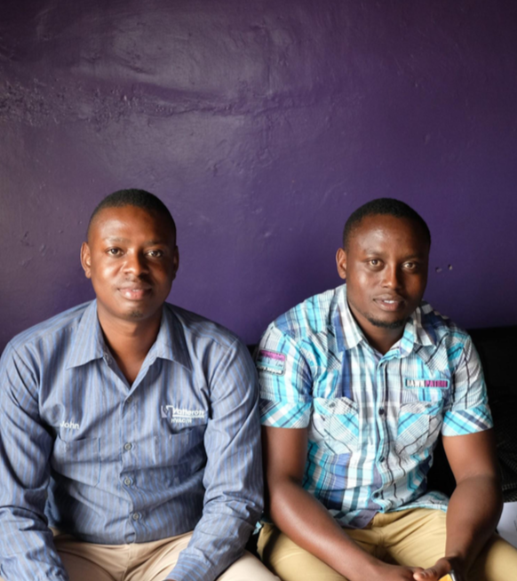

Photo Credit: Ideo.org
HIV Self-Testing Human Centred Design Challenge Fund
The HCD Challenge Fund is a stage-gated, competitive mechanism to prototype and test the best possible design of HIVST delivery models.

Slide 10
Where we are in our timeline
Desk Research
Insight Research
Rough Prototype
Live Prototype
Pilot
Scale-Up
pitch
Phase 1 (March to October 2018)
Phase 2 (2019)

Slide 11
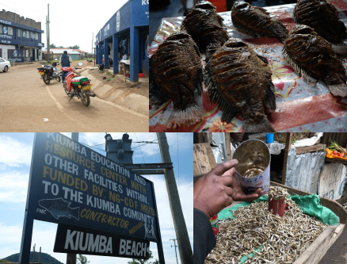
Lessons learned
Plan for an IRB from the beginning
HCD firms and implementer capacities are different
Trust the process, even when it’s messy
Share frameworks upfront
Insight teaser…
“If I tested positive I would need to change my whole life. What you don’t know can’t hurt you.”
--young man, Kibera
Photo Credit: Ideo.org

Slide 12
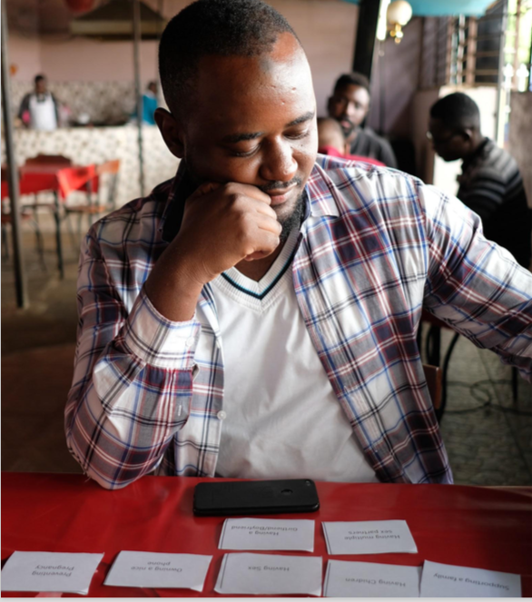

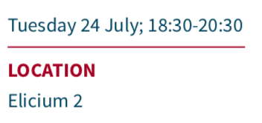
Want to hear more about our insights…
Photo Credit: Ideo.org

Slide 13
Thank you!

Slide 14
CHANGING THE GAME IN
ADOLESCENT-CENTERED DESIGN:
ASSETS, ACCESS, ADHERENCE
#changingthegame #AIDS2108
Please tag @grassrootsoccer

